Slide 1

Accessibility in Announcements & Email

Slide 2
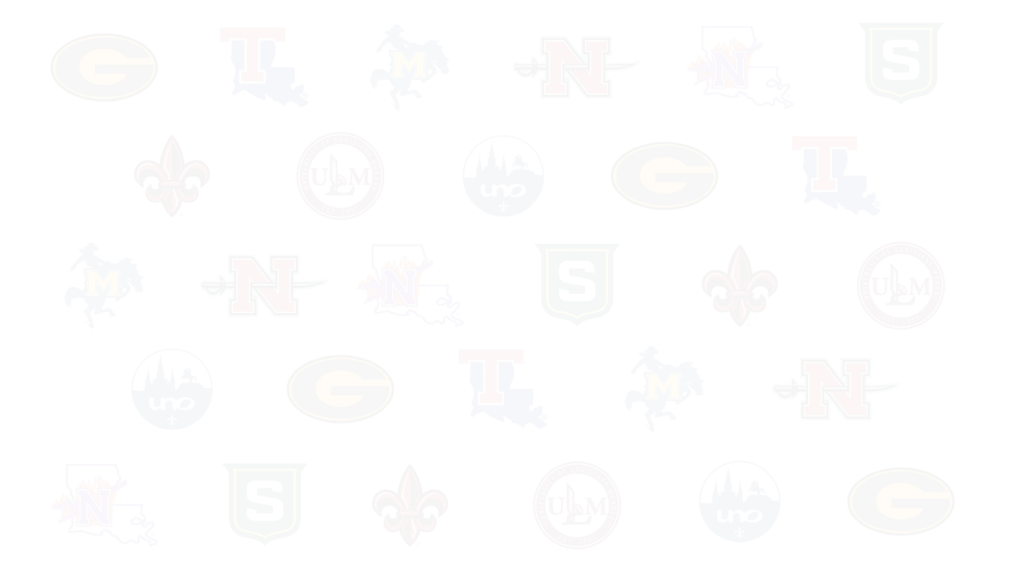
Accessibility Isn’t Just Course Materials
Accessibility applies to:
  Announcements
  Emails
  Event invitations
  Campus-facing updates
If students can’t easily read or navigate your message, they may miss critical information.

Slide 3
The Biggest Accessibility Issues in Emails
No clear subject lines
Long, dense paragraphs
Color used to show importance
Images with text embedded
“Click here” links
Poor mobile formatting

Slide 4
Clear Subject Lines & Structure
Subject lines should be brief but descriptive, and give subscribers an accurate idea of what's in your email.
Best practices:
  Specific subject lines
    ❌ “Important Update”
    ✅ “Deadline Extended: Fall Registration Now Closes Friday”
  Use short paragraphs
  Use bullet points for key details
  Separate sections with spacing

Slide 5
Writing for Readability
Keep sentences short
  Avoid overly complex wording
  Write like you speak (professionally)
Front-load important info
  Put the action or deadline first
  Don’t bury the key message in paragraph three
Avoid unnecessary formatting
  ALL CAPS
  Excessive bolding
  Multiple font styles

Slide 6
Links & Buttons
Avoid:
  ❌ Click here
  Long pasted URLs: https://ul-system.files.svdcdn.com/production/resources/UL-System/Accessibility/M-25-Digital-Accessibility-Policy.pdf?dm=1774977241
Use Descriptive link text:
  ✅ View the Spring 2026 Academic Calendar

Slide 7
Images, Flyers & Attachments
Common issues:
  Sending a flyer image with all the details in the graphic
  Posting a PNG in an LMS announcement
  Attaching inaccessible PDFs
Best practice:
  Always include text in the body of the email.
  If you attach a document, make sure it’s accessible.
  Add alt text to images when possible.

Slide 8
Mobile & Device Considerations
Most students/people read emails on their phones.
Large paragraphs become walls of text.
Test your email on your phone and desktop before sending.

Slide 9
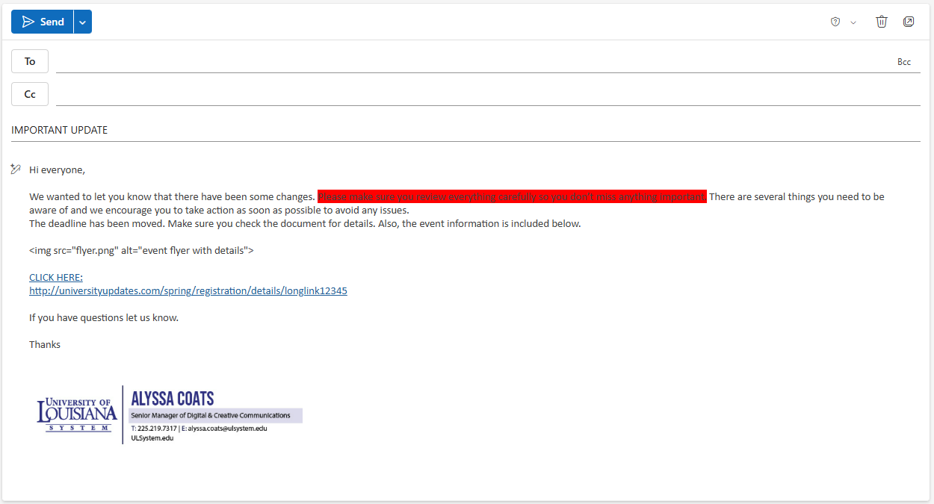
Inaccessible Email Example

Slide 10
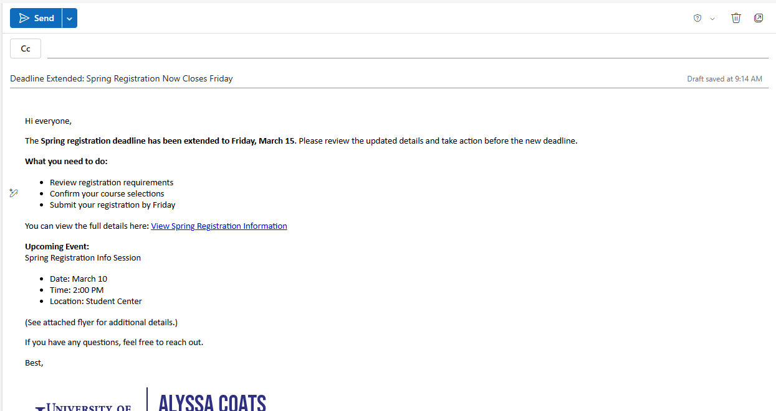
Accessible Email Example

Slide 11
Quick Accessibility Checklist
Before sending, ask:
  Is the subject line specific?
  Is the key message in the first paragraph?
  Are links descriptive?
  Is information available in text (not just in an image)?
  Does it work on mobile?
  Did you use the built-in Accessibility checker?

Slide 12
Email Accessibility Resources
Make your Outlook email accessible to people with disabilities
Accessibility tools for Outlook
Constant Contact: Best practices for designing emails for mobile
Mailchimp: Accessibility in Email Marketing
Mailchimp: Writing for Accessibility

Slide 13
University of Louisiana System logo

