Slide 1

ADA in Data Visualizations

Slide 2

Why Data Visualizations Matter
Data visualizations are everywhere in higher education
Charts and dashboards often replace written explanation
If visuals aren’t accessible, the information is lost
Accessibility here is not “extra”, it’s core communication

Slide 3
What Makes Data Visualizations Hard to Access
Information is often conveyed visually only
Reliance on:
  Color
  Position
  Size
Complex dashboards = high cognitive load
Screen readers can’t interpret visuals without structure

Slide 4
Common Barriers in Data Visualizations
Missing alt text or poor descriptions
No data table alternative
Color-only distinctions (red vs green trends)
Unlabeled axes or legends
Overly complex dashboards

Slide 5
Core Principle #1: Don’t Rely on Color Alone
Color should support, not carry meaning
Always pair color with:
  Direct labels on data
  Patterns (striped, dotted, solid)
  Direct annotations
Example contrast:
  ❌ Red vs. green only
  ✅ Red + labels (“Decline”, “Growth”)

Slide 6
Core Principle #2: Label Clearly and Directly
Use direct labeling instead of legends when possible
Ensure:
  Axes are clearly labeled
  Units are defined
  Abbreviations are explained
Better approach:
  Put the label on the data, not away from it

Slide 7
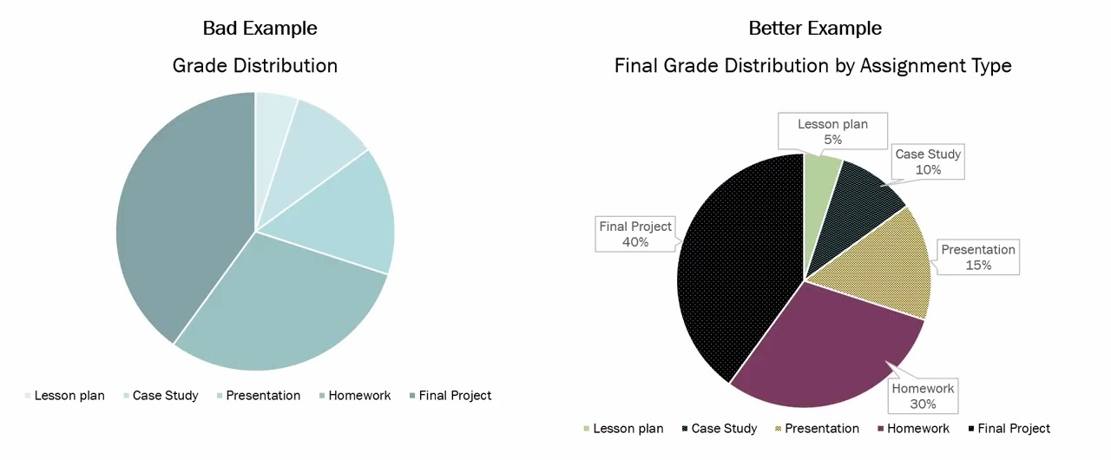
Example – Color Contrast & Data Labels

Slide 8
Core Principle #3: Provide Alt Text Alternatives
Good alt text includes:
  What the chart shows
  Time period
  Key trend or takeaway
  Focus on key insight, not every data point
Example:
  ❌ “Bar chart of enrollment”
  ✅ “Bar chart comparing 2025 enrollment across UL System campuses, showing UL Lafayette with the highest enrollment at approximately…”

Slide 9
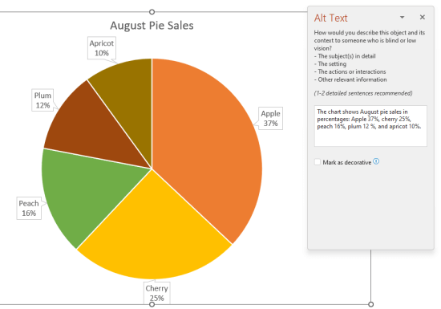
Example – Provide Alt Text Alternatives

Slide 10
Core Principle #4: Keep It Simple
Avoid:
  Cluttered dashboards
  Too many data series
  Unnecessary decoration
Use:
  Whitespace
  Clear hierarchy
  Focus on one message per visual

Slide 11
Core Principle #5: Ensure Readability
High color contrast
Always test in black and white
Legible font sizes
Avoid tiny labels or dense text
Test: can it be read on a small screen?

Slide 12
Core Principle #6: Structure for Screen Readers
Charts alone are not enough
Provide:
  Headings*
  Descriptions
  Logical reading order
If interactive:
  Ensure keyboard navigation works

Slide 13
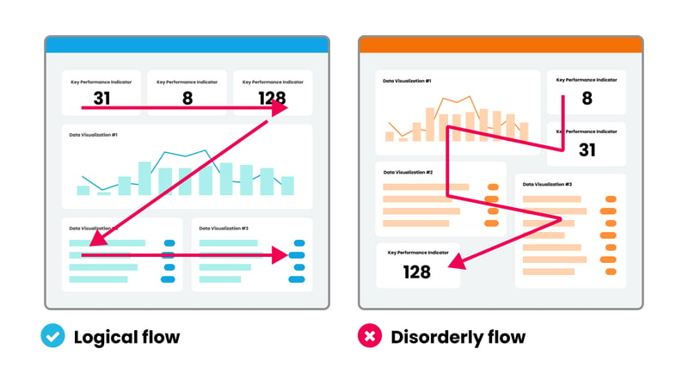
Example – Structure for Screen Readers

Slide 14
Dashboards & Interactivity
Common issues:
  No clear navigation
  Unlabeled filters or buttons
  Cognitive overload
Best practices:
  Grouped sections
  Clear labels for filters
  Clear Headings
  Summary box at the top

Slide 15
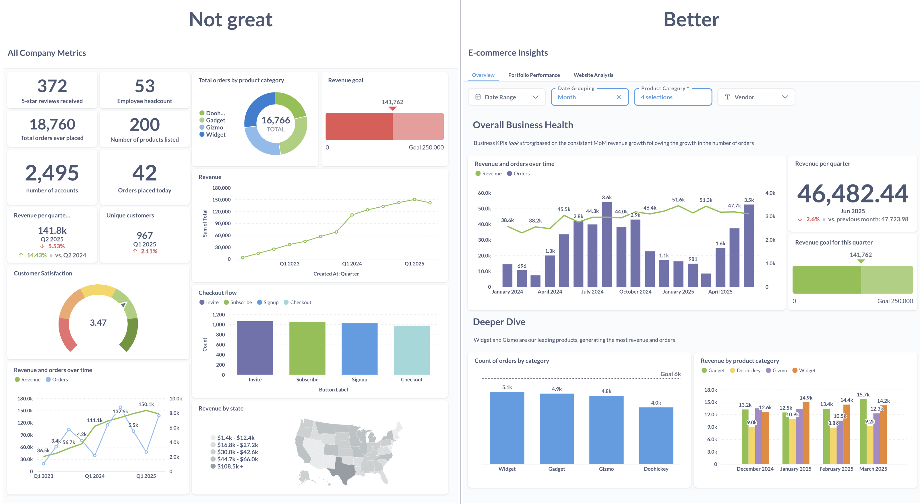
Example – UL System Dashboard Scenario

Slide 16
Alternative Ways to Communicate Data
When visuals aren’t enough:
  Written summaries (“key findings” sections)
  Bullet point insights
  Narrated walkthroughs in reports
  Downloadable CSV or Excel data
    Example text about chart: “Here we provide both the bar chart and a link to the data in table form."

Slide 17
Data Visualization Resources
10 basic guidelines to make data visualizations more accessible
U.S. Web Design Systems (USWDS) – Data Visualizations
Best Practices for Designing Accessible Views
Build Accessible Dashboards

Slide 18
University of Louisiana System logo

