Slide 1

Color Contrast & Visual Design Basics

Slide 2

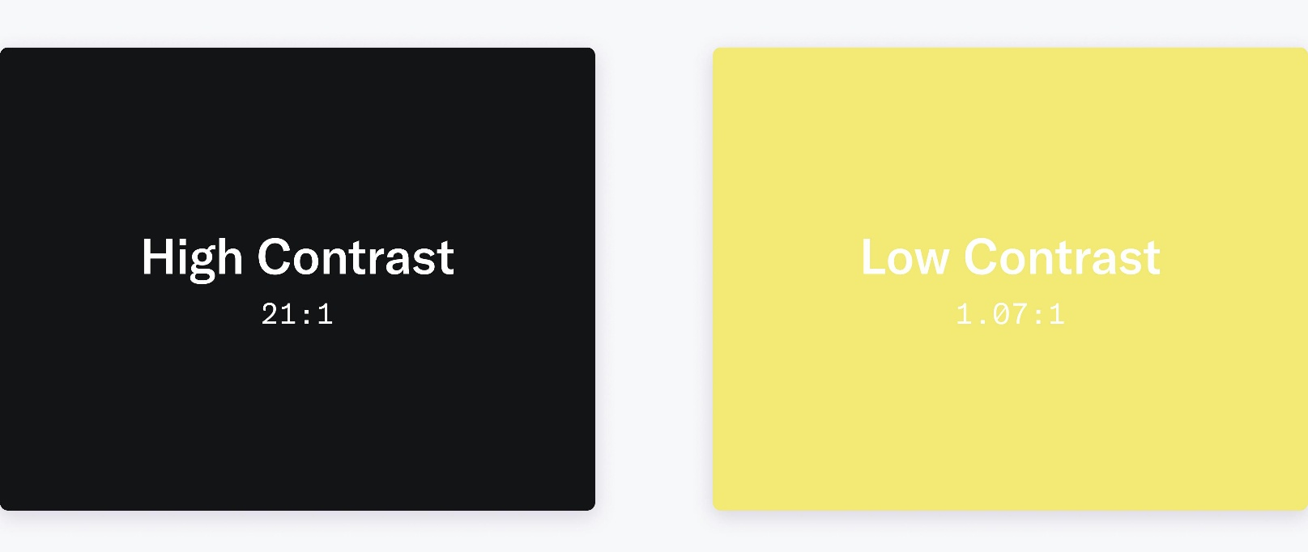
What Is Color Contrast?
Color contrast is the difference between text (or elements) and their background.
Low contrast is unreadable content, even if the colors are “on brand.”

Slide 3
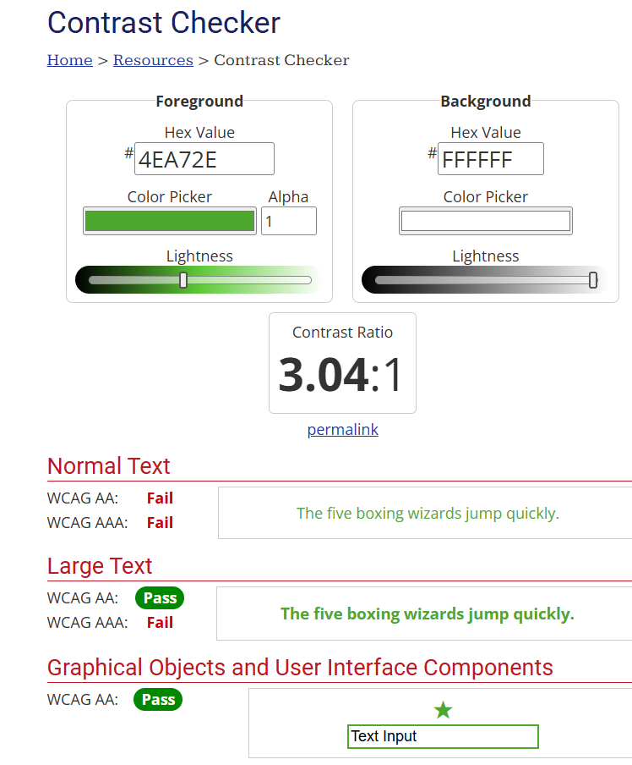
Color Contrast Standards
Contrast ratio: measure of difference in brightness
1:1 = same color; 21:1 highest possible
Most text and images: Contrast ratio of 4.5: 1
Large scale (min 18 pt or 14 pt bold) text: Contrast ratio minimum 3:1
Graphs and charts: 3:1

Slide 4
Why Color Contrast Matters
Good contrast ensures that:
  People with low vision can read and interpret information
  Users with colorblindness can differentiate elements
  Mobile users in bright lighting can still see the content
  Charts, diagrams, and images remain understandable to everyone
Poor contrast is one of the most common accessibility failures in documents, LMS pages, videos, and lecture slides.

Slide 5
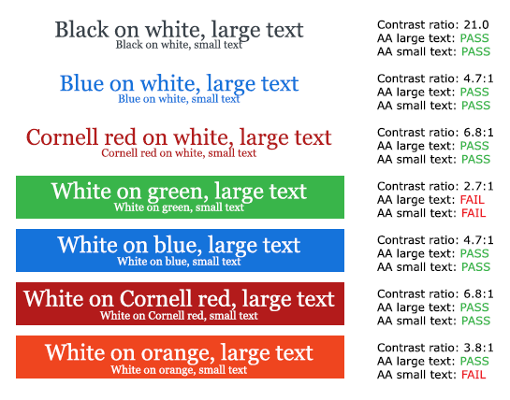
Color Contrast Examples

Slide 6
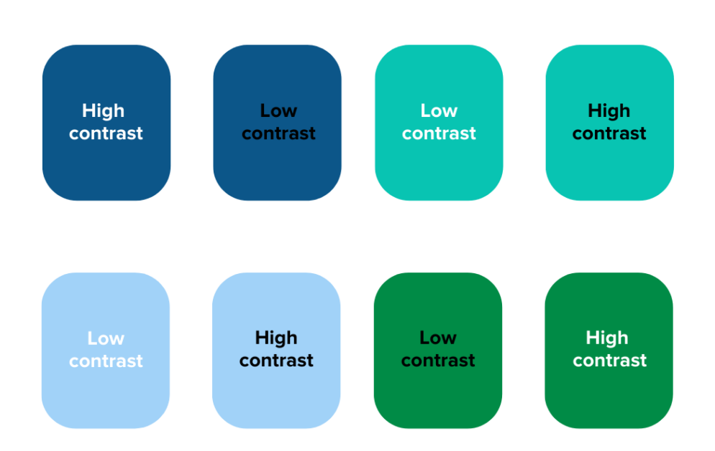
Low & High Color Contrast Examples

Slide 7
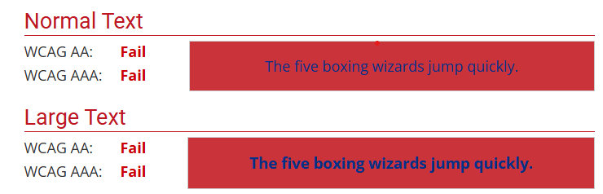
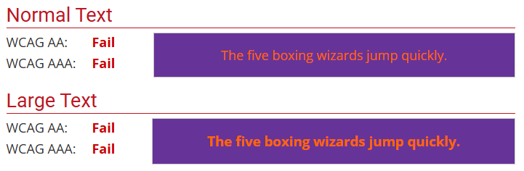
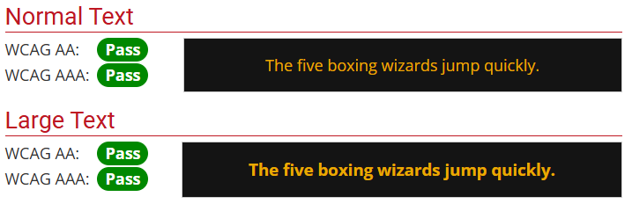
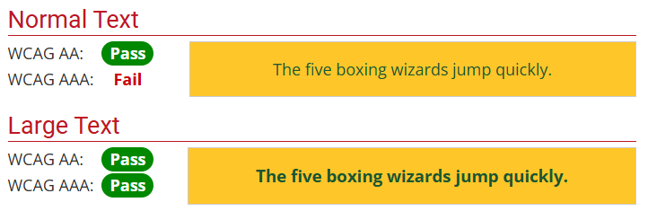
Low & High Color Contrast Examples - Branding

Slide 8
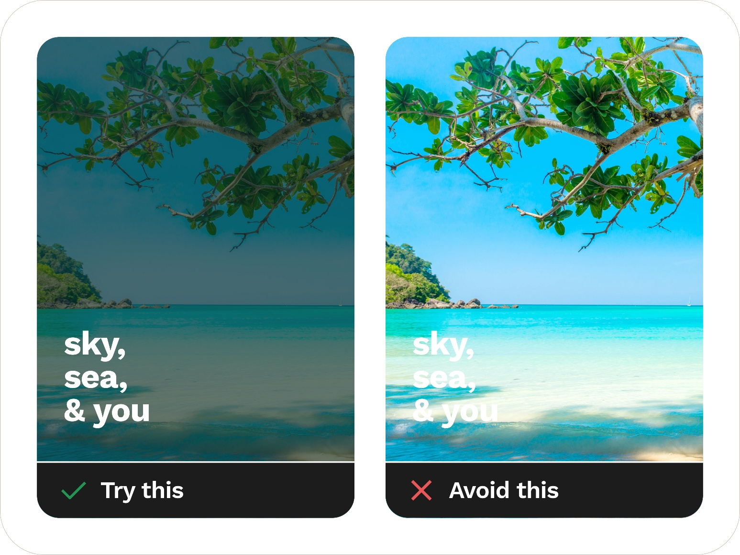
Contrast with Backgrounds behind Text

Slide 9
Design for Accessibility
Color Should Not Be the Only Indicator
Text Readability (Font Selection)
Layout, Labels, & Hierarchy

Slide 10
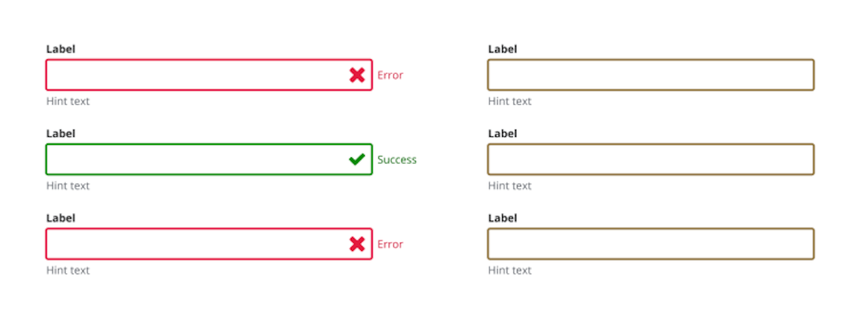
Add Descriptions if Using Color
Include accessible icons and descriptions with color differentiation.

Slide 11
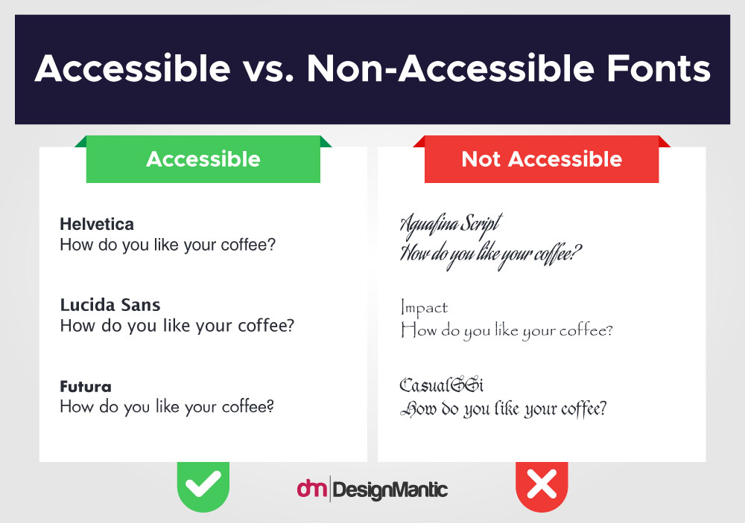
Readable Fonts

Slide 12
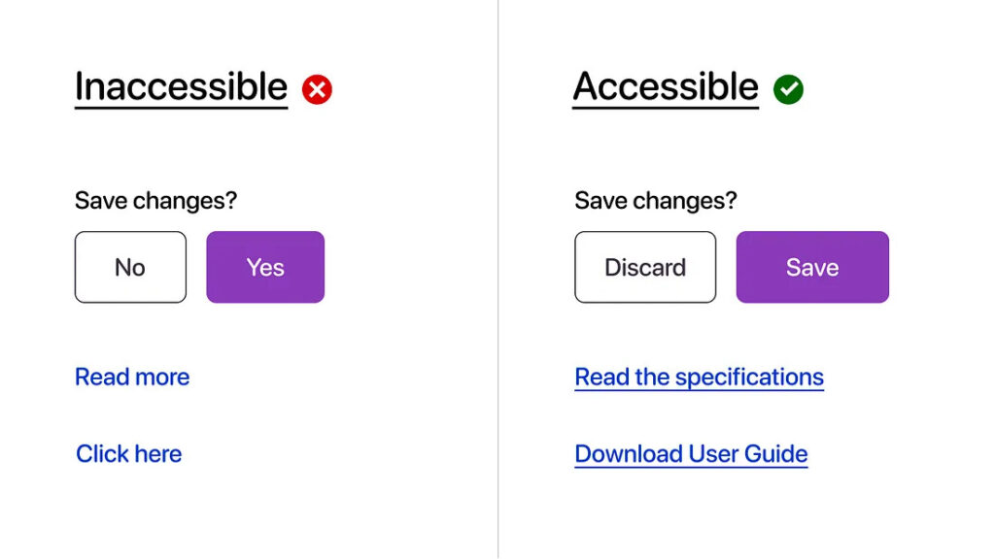
Clear Labels

Slide 13
Practical Design Checkpoints
Can I read this on my phone?
Does it still work if I remove color?
Is text sitting on a solid background?
Did I test contrast instead of guessing?

Slide 14
Color & Design Rules Resources
Tools to help you design with colorblindness in mind:
  A great explanation of color font ratios.
  WebAim’s color contrast checker: provide two colors to see if they pass accessibility guidelines.
  Color Oracle: a color blindness simulator for Windows, Mac and Linux, showing you what people with common color vision impairments will see.
Checks to help you check design accessibility:
  Microsoft Office Accessibility Checkers​
  WAVE (for online docs and media players) ​
  PDF Accessibility Checker – PAC (Windows only)
  A Web Designer’s Complete Guide to Accessible Fonts

Slide 15
University of Louisiana System logo

